Slide 1
Discretionary Grant Online Application
Notes:
NB: 1. This template uses Masters that are accessable and editable under the Master view which can be accessed by going to the View tab > Under the Master Views tab choose “Slide Master”, all the slide masters will appear and can be edited there.
2. If you would like to add a slide, go to Home > New Slide > Under Office Theme all the designed slide layouts will appear and you can choose a layout that will suit your needs or that will suit the content that you would like to add onto your slide.

Slide 2
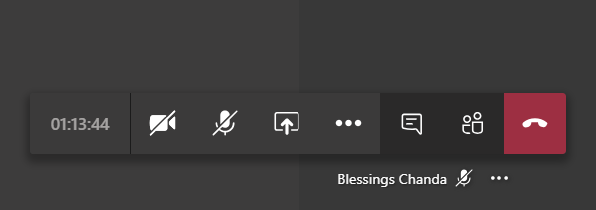
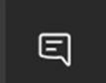

Meeting protocols
Please disable
Please use to interact
Please disable

Slide 3
Agenda
Welcome
High-level overview: DG Process
Online training
Q&As (also make use of the chat, INSETA team will respond to the best of their ability)

Slide 4
Discretionary Grant workflow
1
2
4
3

Slide 5


Please visit our website and click on banner
1
1
1
2
Access Online system, click on LOGIN

Slide 6
Support Contact: Information
Manager: Akhona Wotshela
Learnerships - learnerships@inseta.org.za
Internships - internships@inseta.org.za
Bursaries for Youth – bursariesforyouth@inseta.org.za
Work-Integrated-Learning – wil@inseta.org.za
akhonaw@inseta.org.za
Manager: Nasreen Ravat
Bursaries for Workers -
Bursaryforworkers@inseta.org.za
Skills Programs for Workers -SP4WCashGrant@inseta.org.za
nasreenr@inseta.org.za

Slide 7
END OF THE PRESENTATION

