Slide 1

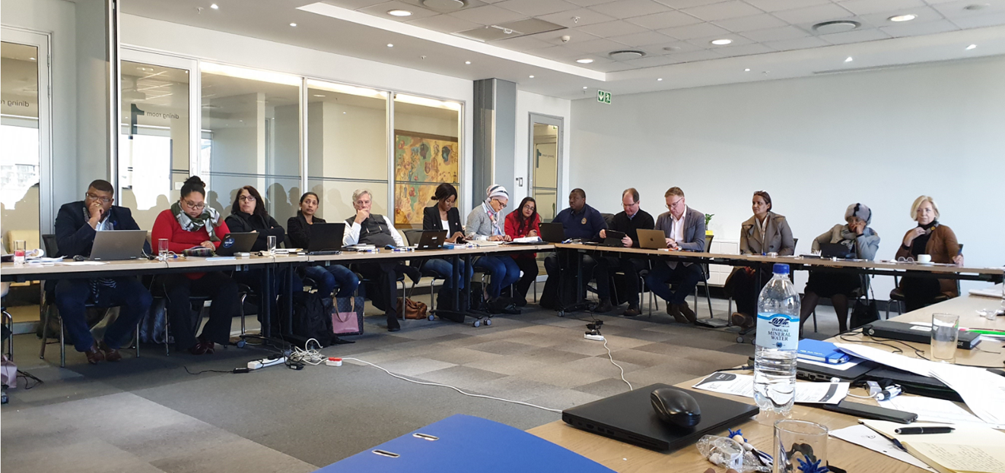
INSETA RESEARCH & LEARNING COMMITTEE 2020
WSP DATA ANALYSIS & RESULTS OF THE COVID SURVEY

Slide 2

Background to Research @ INSETA
WSP DATA
    Data collected from Workplace Skills Plan submissions from Employers ( 1243 participants)
      Development of the Sector Skills plan research report

Slide 3
Research @ INSETA – EMPLOYER DATA
Large insurance companies (+150 employees) comprise 82% of the workforce. Medium insurance companies (+50-149 employees) comprise 8.8% of the workforce. Small insurance companies (1-49 employees) comprise 9.2% of the workforce. The bulk of employment is in large insurance companies.

Slide 4
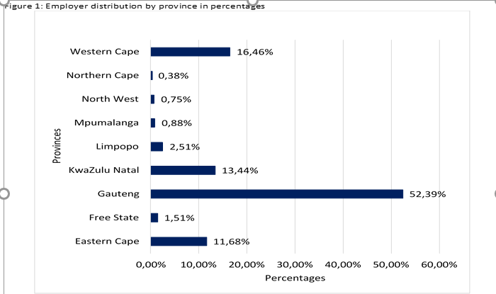
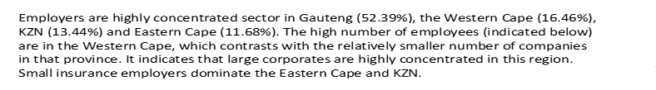
Research @ INSETA – EMPLOYER DATA

Slide 5
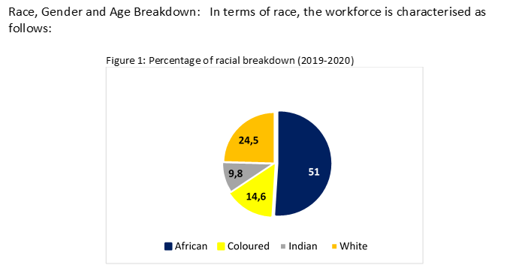

Research @ INSETA – EMPLOYER DATA

Slide 6
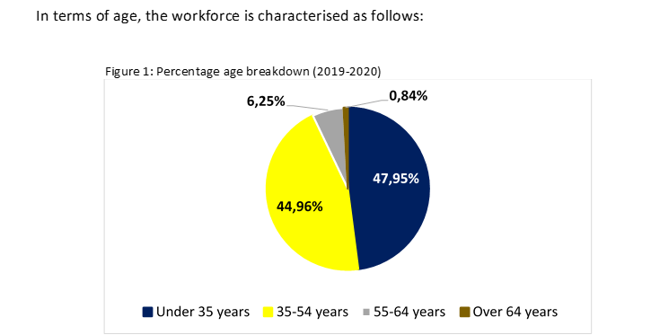

Research @ INSETA – AGE

Slide 7
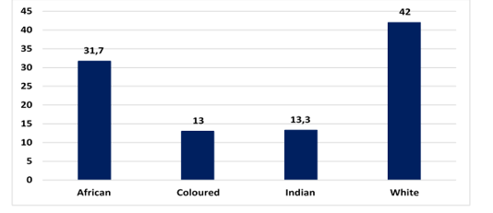
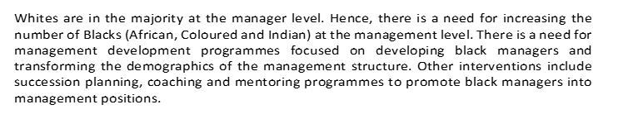
Research @ INSETA – MANAGERS

Slide 8
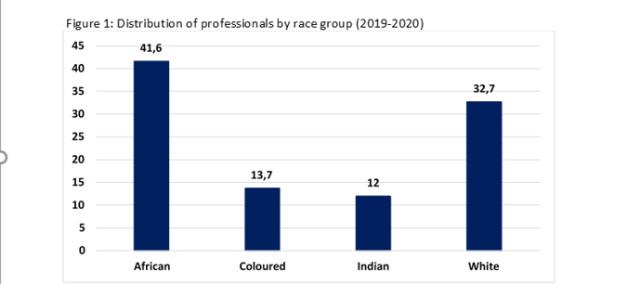
Research @ INSETA – PROFESSIONALS

Slide 9
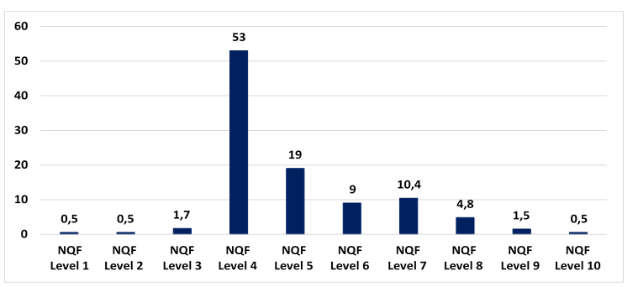
Research @ INSETA – EDUCATIONAL PROFILE

Slide 10
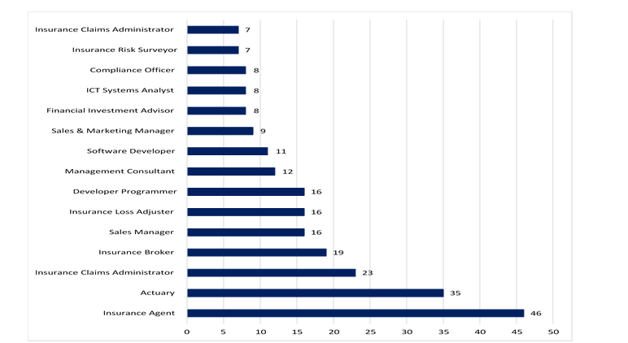
Research @ INSETA – Hard to Fill Vacancies

Slide 11
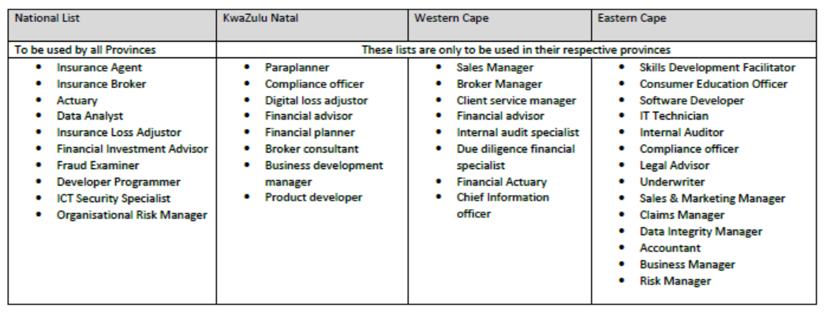
National Scarce & Critical Occupations 2019 - 2021

Slide 14
CONSULTATIONS WITH THE SECTOR
 | Large & Medium 19 /20
Retrenchment | 652 – 2019 907 - 2020
Dismissed due to misconduct | 3131 – 2019 4817 - 2020
Resignations | 17 242 – 2019 24 843 - 2020
Deceased | 134 – 2019 230 – 2020
Retired | 390 – 2019 647 - 2020
Dismissed due to Non compliance with RE | 165 – 2019 108 - 2020
Dismissed due to inCapacity | 693 – 2019 257 - 2020
Small- 2019
120
125
1076
25
36
8
17

Slide 15
Age Profiles
AGE – Large & Medium Companies | Numbers
Age Group - Less than 35 | 68334 – 2019 95 534 - 2020
Age Group - 35 to 54 | 62667 – 2019 86 974 - 2020
Age Group - 55 to 64 | 7854 – 2019 11 408 – 2020
Age Group - Greater than 64 | 888 – 2019 1495 - 2020
AGE - Small | Numbers
Age Group - Less than 35 | 3681
Age Group - 35 to 54 | 4436
Age Group - 55 to 64 | 1120
Age Group - Greater than 64 | 286

Slide 16

Age Profile over last 4 years
Year | Employees over the age of 65 - Small | Employees over the age of 65 - Large | Retirees Occupations
2019 2018 | 286 281 | 888 945 | Underwriter, CEO, Director, IT & Developer, Network Architect, Product Developer, Compliance Officer
2017 | 281 | 824
2016 | 282 | 867

Slide 17

Prioritise as a Business

Slide 18
COVID 19 SURVEY RESULTS

Slide 19
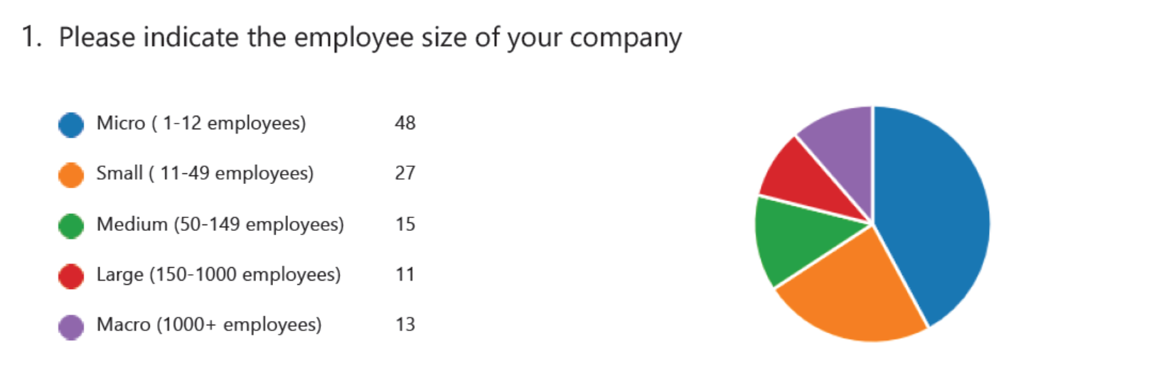
COVID SURVEY RESULTS

Slide 20
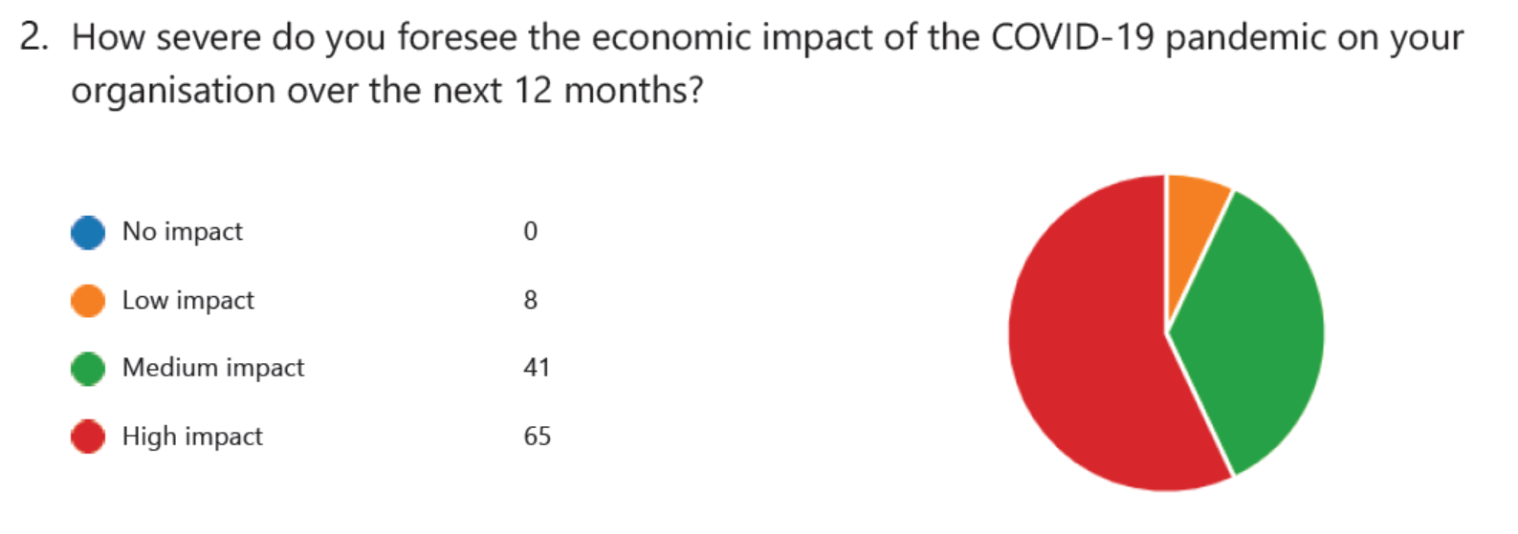
ECONOMIC IMPACT OF COVID ON THE BUSINESS

Slide 21
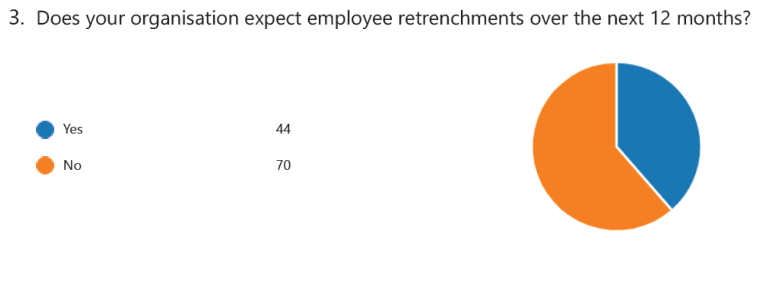
EXPECTATION OF EMPLOYEE RETRENCHMENTS

Slide 22
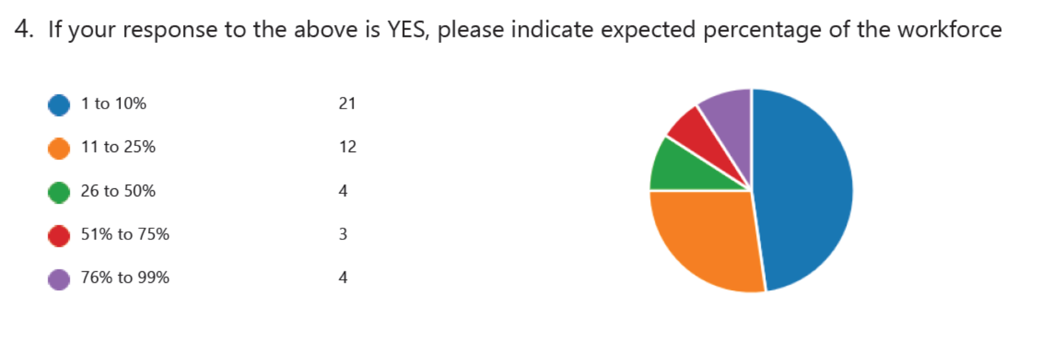
PERCENTAGE OF WORKFORCE AFFECTED

Slide 23
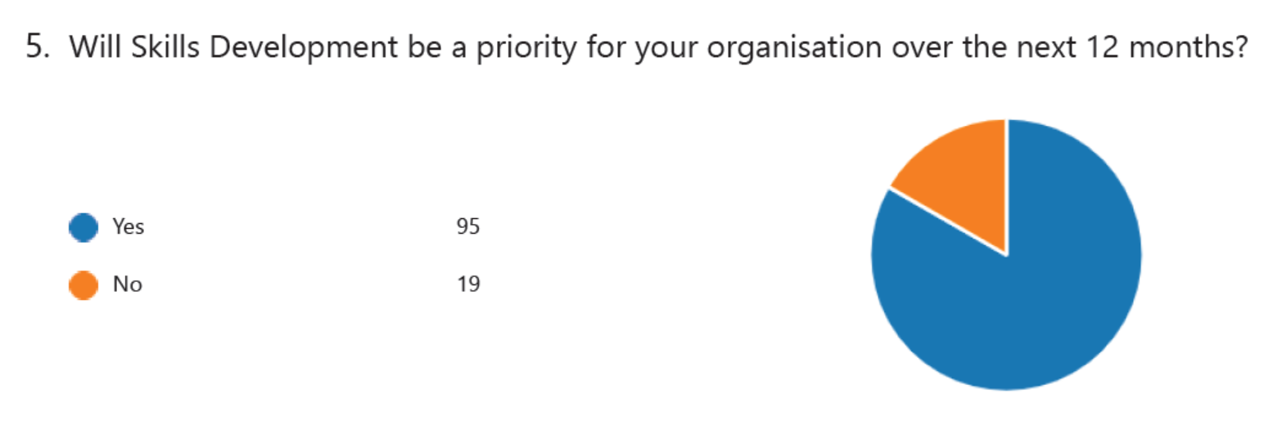
SKILLS DEV. AS A PRIORITY OF THE COMPANY OVER NEXT 12 MONTHS

Slide 24
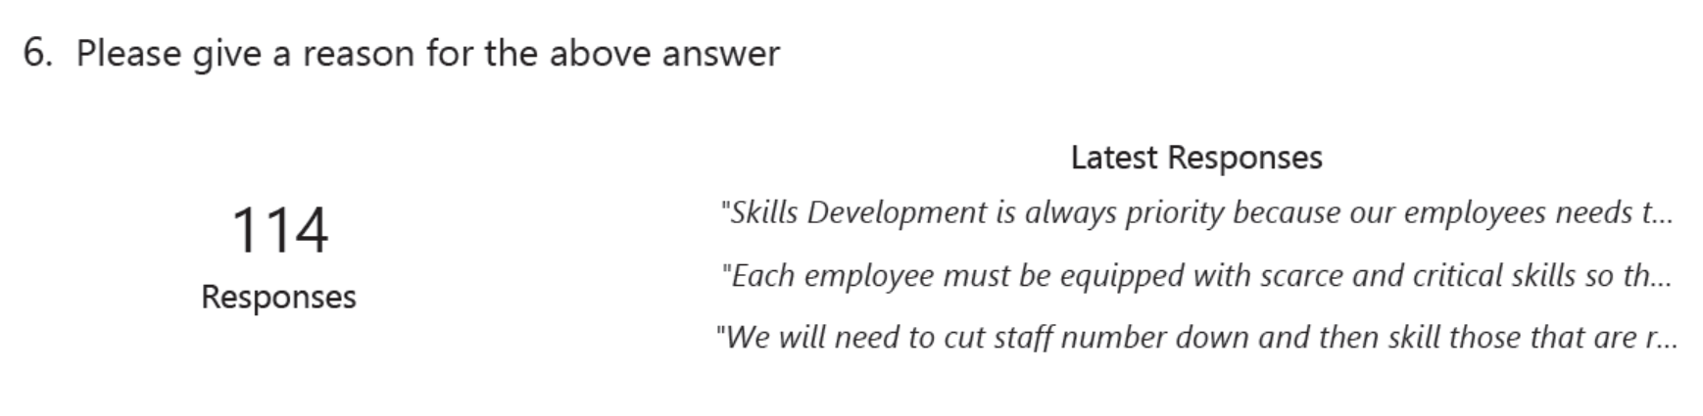
REASON

Slide 25
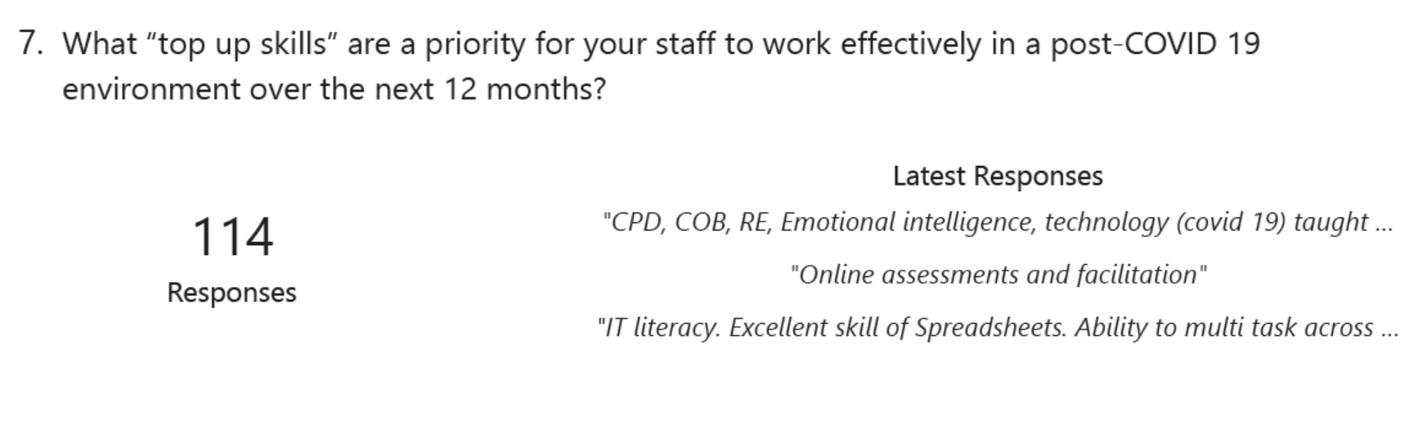
TOP UP SKILLS NEEDED FOR STAFF

Slide 26
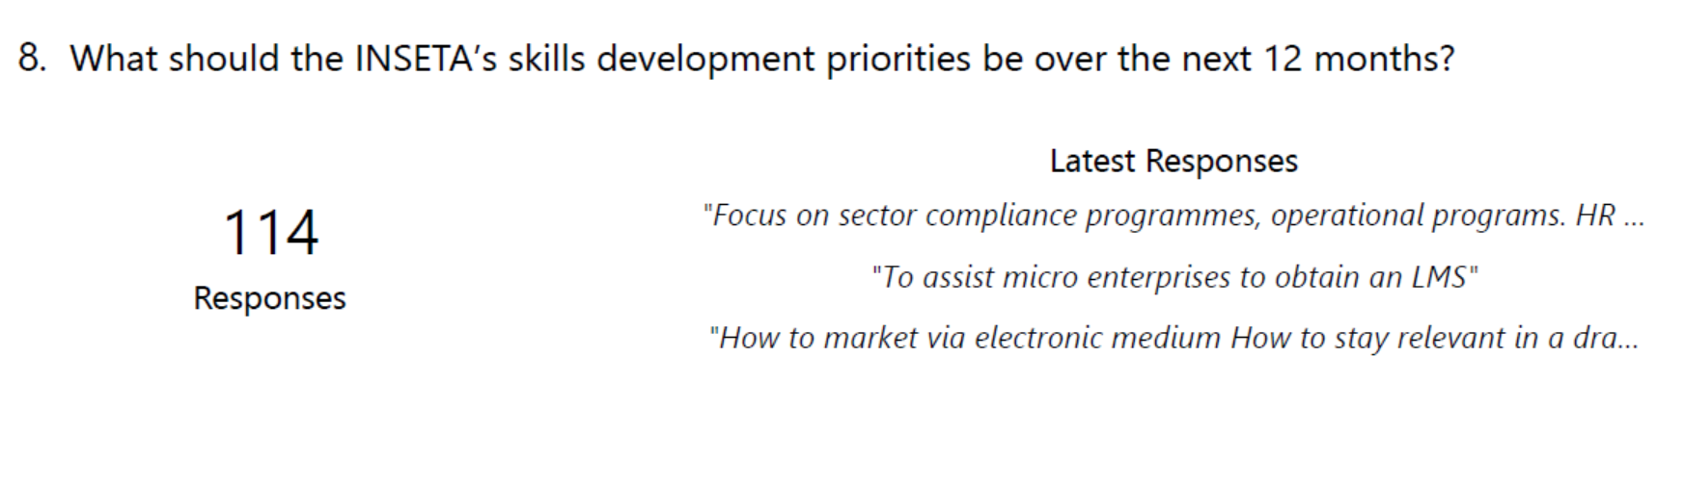
SKILLS PRIORITIES OVER NEXT 12 MONTHS

Slide 27
Research Team
ADELINE SINGH
adelines@inseta.org.za
HOOSEN RASOOL
hoosenr@inseta.org.za
ERNEST KAPLAN
ernestk@inseta.org.za

